Slide 1
CREDIT CARD FRAUD DETECTION
A Machine Learning Approach to Identifying Fraudulent Transactions
Data Science Internship Project

Slide 2
Project Overview
Building an end-to-end fraud detection pipeline
🎯
⚖️
🔧
📊
Objective
Challenge
Approach
Outcome
Identify fraudulent credit card transactions using historical transaction data.
Severe class imbalance: only 1.478% of transactions are fraudulent.
Clean data, engineer features, balance classes with SMOTE, and compare classification models.
A tuned Random Forest model with 0.9846 ROC-AUC on held-out data.
Credit Card Fraud Detection
2

Slide 3
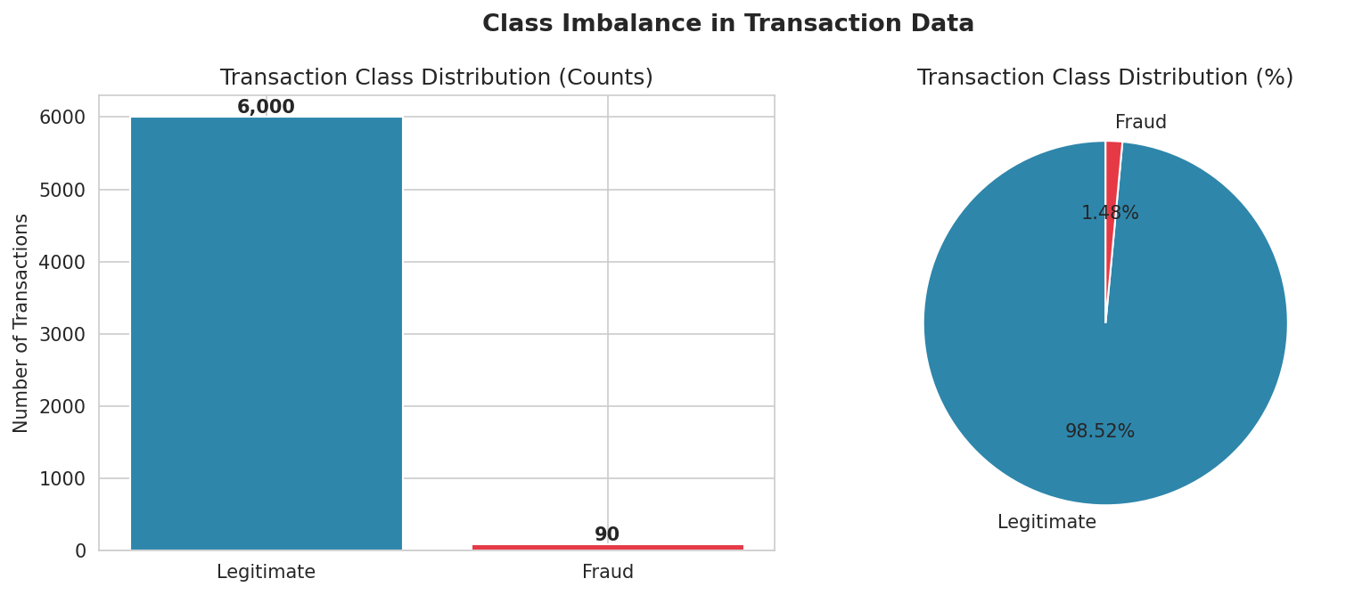
Dataset & Class Imbalance
Working dataset structure and fraud prevalence
Total Transactions
6,090
Fraud Cases
90
Fraud Rate
1.478%
Features
Time, Amount, 28 anonymized (V1–V28)
Credit Card Fraud Detection
3

Slide 4
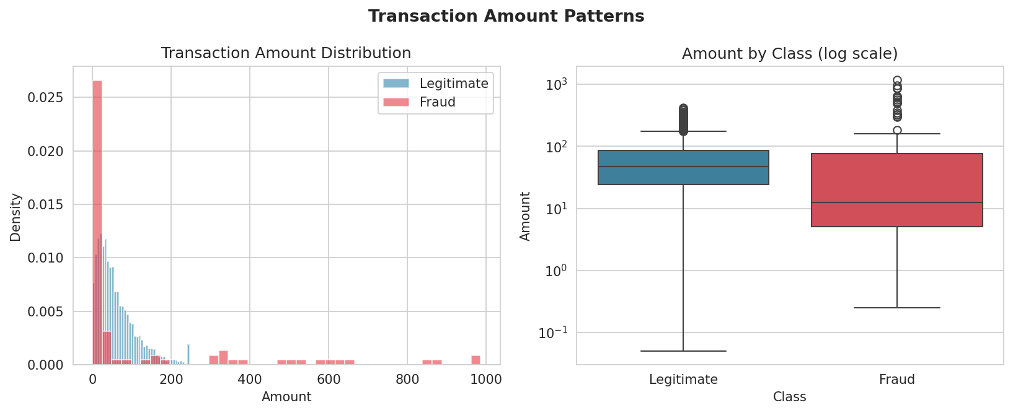
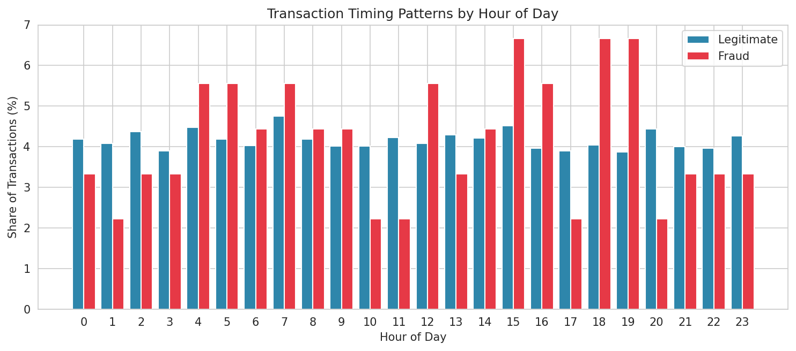
Transaction Amount & Timing Patterns
Fraud behaves differently from legitimate spending
Fraud skews toward smaller "testing" amounts (median $12.54) vs. legitimate purchases (median $47.62), and peaks around hour 18:00.
Credit Card Fraud Detection
4

Slide 5
Handling Class Imbalance
Synthetic Minority Oversampling (SMOTE)
1
Split the data
Stratified train/test split preserves the true fraud rate in the held-out test set.
2
Scale features
Standardize all numeric features before distance-based oversampling.
3
Apply SMOTE
Generate synthetic fraud examples along the line between real fraud cases and their nearest neighbors.
4
Train on balanced data
Models train on a 50/50 balanced set, then are evaluated on the original imbalanced test set.
Credit Card Fraud Detection
5

Slide 6
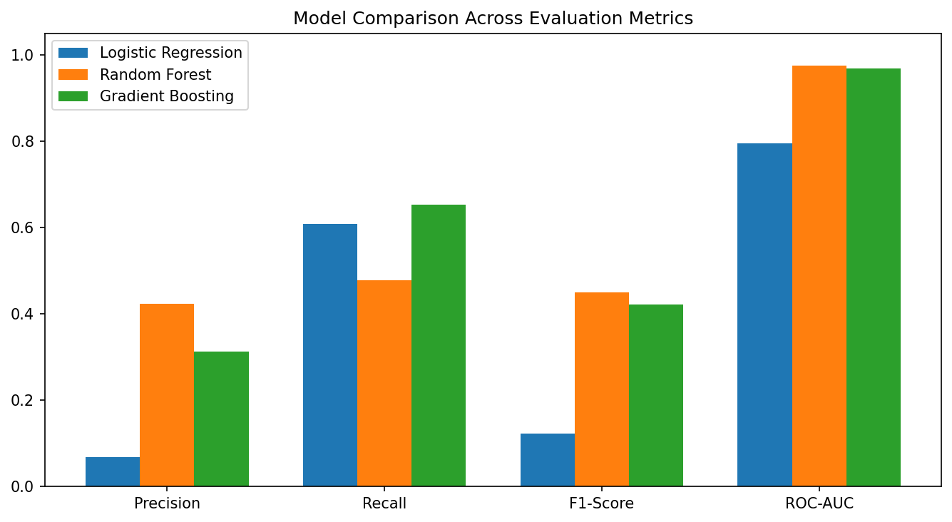
Model Comparison
Three classifiers evaluated on the same held-out test set
Credit Card Fraud Detection
6

Slide 7
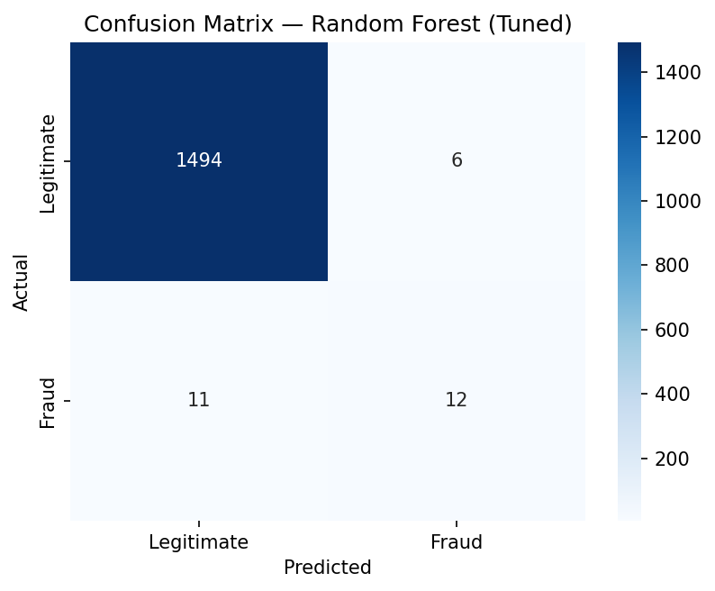
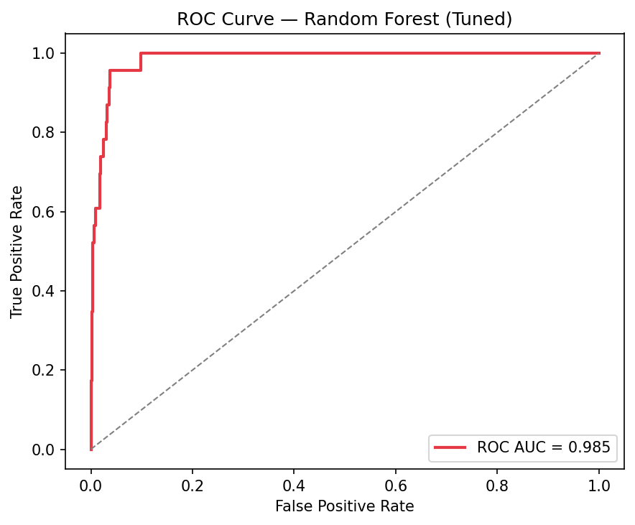
Final Model Performance
Random Forest (tuned with GridSearchCV)
0.6667
0.5217
0.5854
0.9846
Precision
Recall
F1-Score
ROC-AUC
Credit Card Fraud Detection
7

Slide 8
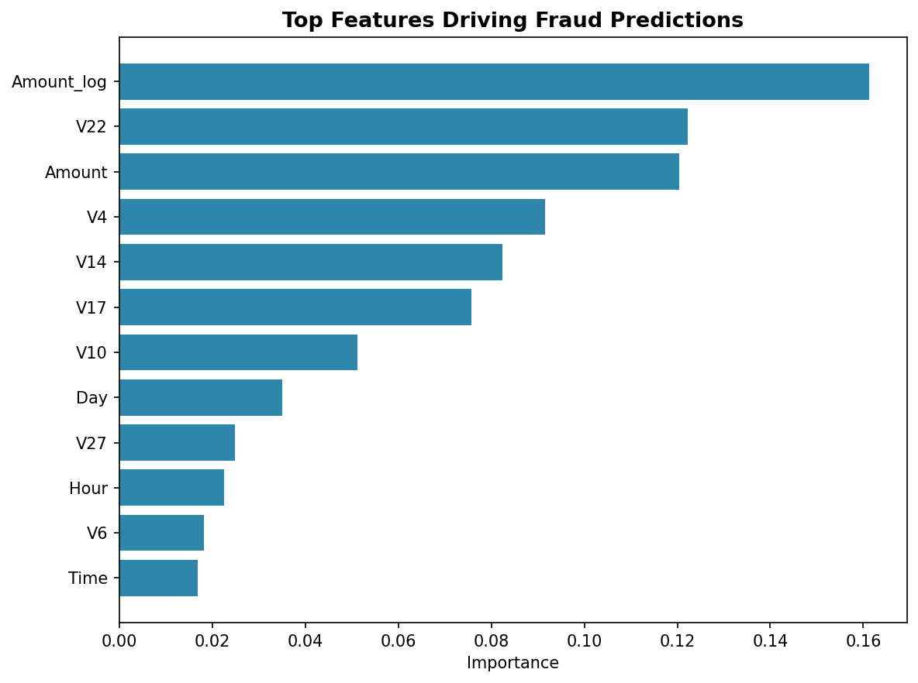
Fraud Pattern & Feature Importance
What drives the model's fraud predictions
Top Signals
Amount_log
16.1%
V22
12.2%
Amount
12.0%
V4
9.2%
Transaction amount and a small set of anonymized behavioral features carry most of the predictive signal.
Credit Card Fraud Detection
8

Slide 9
Business Insights & Recommendations
Turning model results into action
Key Findings
Recommendations
Fraud skews toward small "testing" charges before larger attempts.
Fraud incidence peaks in the evening hours.
A small set of features drives most predictive power, enabling fast scoring.
Use the model as a first-pass screening layer ahead of manual review.
Apply extra scrutiny to low-value transactions during peak fraud hours.
Retrain periodically as fraud patterns evolve; monitor precision/recall drift.
Credit Card Fraud Detection
9

Slide 10
Thank You
Questions & Discussion

